Slide 1
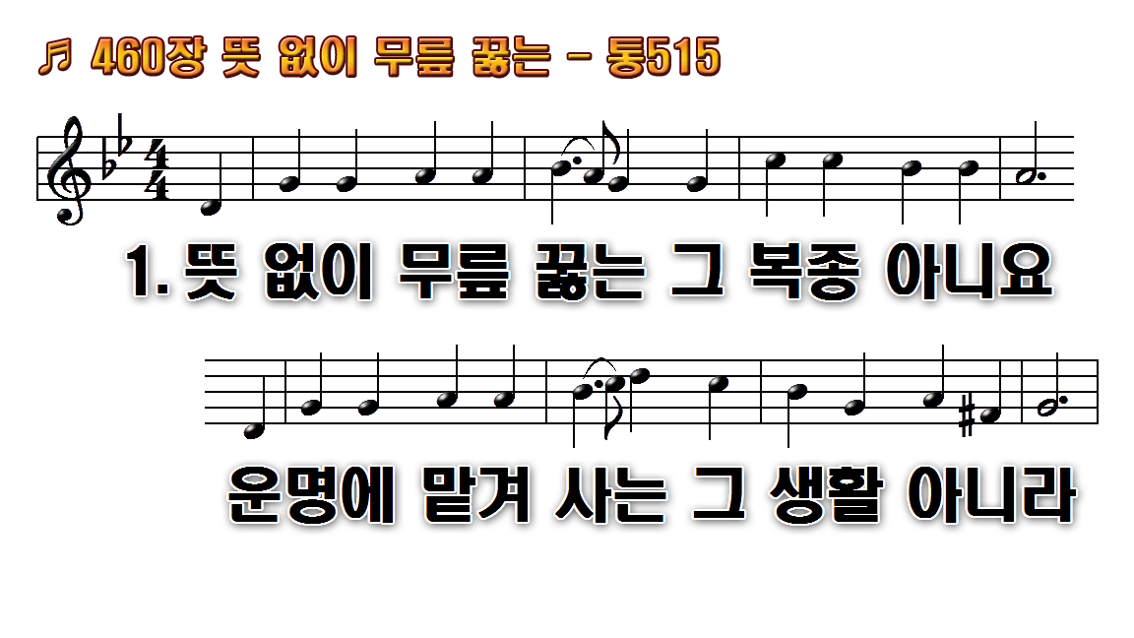
1
2

Slide 2

1
2

Slide 3
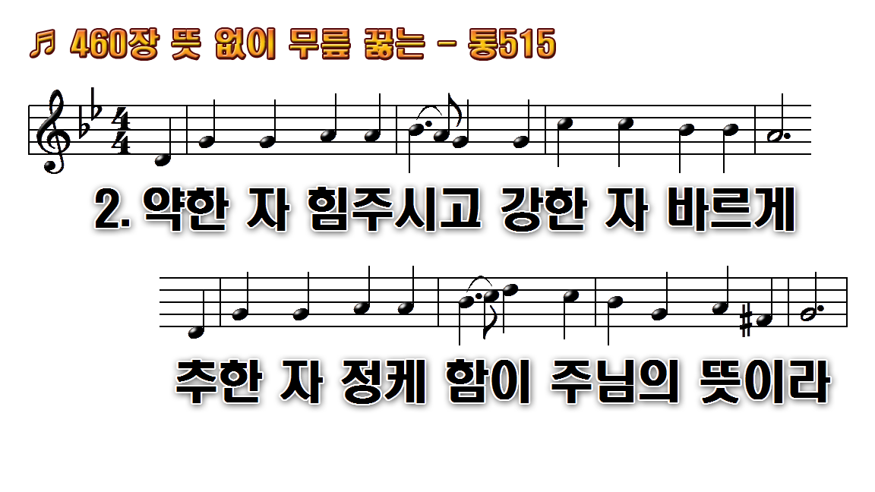
1
2

Slide 4

1
2

